Slide 1
MATHEMATICAL FOUNDATION FOR COMPUTER SCIENCE
Prepared by: Er. Ankit Kharel
Nepal college of information technology

Slide 2
Rules of inference

Slide 3
ARGUMENT:
An argument is a sequence of proposition written as:
P₁, P₂ …..are called the Hypothesis or premises and the proposition Q is called Conclusion.
The argument is valid provided that P₁, P₂ ……and P_{n} all are TRUE ,then Q also must be TRUE.
This process of Drawing a conclusion from a sequence of proposition is called Deductive Reasonong
P₁
P₂
.
.
. (P₁^P₂……..P_{n})→Q is TAUTOLOGY
.
.
.
P_{n}
∴ q_{n}

Slide 4
RULES OF INFERENCE:
If an argument consists of 10 different proposition variable then 2¹⁰=1024 combination are needed for Truth Table which is a tedious approach.
Instead we can first establish the validity of some relatively simple arguments forms, called Rules of Inference.
These rules then can be used to construct more complicated valid arguments.

Slide 5
1. MODUS PONENS:
It states that if P and P→Q is TRUE then, we can infer Q is true.
That is, (P^(P→Q))→Q is TAUTOLOGY
p → q
p
∴ q
Proof By Truth Table:
p | q | p→q | (p→q) ^p | ((p→q) ^p)→q
T | T | T | T | T
T | F | F | F | T
F | T | T | F | T
F | F | T | F | T

Slide 6
2. MODUS TOLLENS:
It states that if P→Q and ¬Q is TRUE then, we can infer ¬P is true.
That is, (¬q^(P→Q))→¬P is TAUTOLOGY
p → q
¬q
∴ ¬p
Proof By Truth Table:
p | q | p→q | ¬p | ¬q | (p→q) ^¬q | (p→q) ^¬q)→¬p
T | T | T | F | F | F | T
T | F | F | F | T | F | T
F | T | T | T | F | F | T
F | F | T | T | T | T | T

Slide 7
3. HYPOTHETICAL SYLLOGISM:
It states that if P→Q and Q→R is TRUE then, we can infer P→R is true.
That is, ((P→Q)^(Q→R))→(P→R) is TAUTOLOGY
p→q
q→r
∴ p→r
P | q | r | p→q | q→r | p→r | (p→q)^(q→r) | ((p→q)^(q→r))→(p→r)
T | T | T | T | T | T | T | T
T | T | F | T | F | F | F | T
T | F | T | F | T | T | F | T
T | F | F | F | T | F | F | T
F | T | T | T | T | T | T | T
F | T | F | T | F | T | F | T
F | F | T | T | T | T | T | T
F | F | F | T | T | T | T | T

Slide 8
4. DISJUNCTIVE SYLLOGISM:
It states that if PvQ and ¬P is TRUE then, we can infer Q is true.
That is, (¬P^(PvQ))→Q is TAUTOLOGY
pVq
¬p
∴ q
Proof By Truth Table:
p | q | pVq | ¬p | (pVq)^¬p | ((pVq)^¬p)→q
T | T | T | F | F | T
T | F | T | F | F | T
F | T | T | T | T | T
F | F | F | T | F | T

Slide 9
5. ADDITION:
It states that if P is TRUE then, P^Q will be TRUE.
That is, P→(PvQ) is TAUTOLOGY
p
∴ pVq
Proof By Truth Table:
p | q | pVq | P→(pVq)
T | T | T | T
T | F | T | T
F | T | T | T
F | F | F | T

Slide 10
6. SIMPLIFICATION:
It states that if P^Q is TRUE then, P will be TRUE.
That is, (P^Q)→P is TAUTOLOGY
p^q
∴ p
Proof By Truth Table:
p | q | p^q | (p^q)→p
T | T | T | T
T | F | F | T
F | T | F | T
F | F | F | T

Slide 11
7. CONJUNCTION:
It states that if P is TRUE and Q is TRUE then, P^Q will be TRUE.
That is, (P)^(Q)→(P^Q) is TAUTOLOGY
p
q
∴ p^q
Proof By Truth Table:
p | q | p^q | (p^q)→(p^q)
T | T | T | T
T | F | F | T
F | T | F | T
F | F | F | T

Slide 12
8. RESOLUTION:
It states that if (PvQ) and (¬PvR) is TRUE then, we can infer (QvR) is true.
That is,((PvQ)^(¬PvR))→(QvR) is TAUTOLOGY
pVq
¬pVr
∴ qVr
p | q | r | ¬p | pVq | ¬pVr | qVr | ((pVq)^(¬pVr))→(qVr)
T | T | T | F | T | T | T | T
T | T | F | F | T | F | F | T
T | F | T | F | T | T | T | T
T | F | F | F | T | F | F | T
F | T | T | T | T | T | T | T
F | T | F | T | T | T | T | T
F | F | T | T | F | T | T | T
F | F | F | T | F | T | T | T

Slide 13
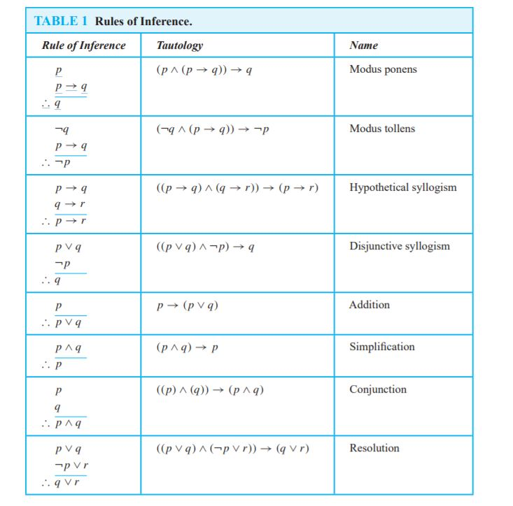
RULES OF INFERENCE:

Slide 14
Q.1)State which rule of inference is the basis of the following argument:
“It is below freezing now. Therefore, it is either below freezing or raining now.”
Solution:
Let, p : “It is below freezing now”
q : “It is raining now.”
Then this argument is of the form:
p
∴ p ∨ q
This is an argument that uses the addition rule.
Q.2)State which rule of inference is the basis of the following argument:
“It is below freezing and raining now. Therefore, it is below freezing now.”
Solution:
let, p: “It is below freezing now,”
q : “It is raining now.”
This argument is of the form:
p ∧ q
∴ p
This argument uses the simplification rule.

Slide 15
Q.3) Show that the premises: “If I play football then I am tired the next day”, “I will take rest if I am tired”, “I did not take rest” will lead to the conclusion “I did not play football”.
Solution:
Let, p: “If I play football”
q: “I am tired”
r: “I will take rest ”
Hypothesis: i) p→q
ii) q →r
iii) ¬r
Conclusion: ∴ ¬p
s.n. | STEPS | REASONS
1. | p→q | Given Hypothesis
2. | q→r | Given Hypothesis
3. | p→r | HYPOTHTICAL SYLLOGISM IN 1 & 2
4. | ¬r | Given Hypothesis
5. | ¬p | MODUS TOLLENSON 3 & 4

Slide 16
Q.3) Show that the premises “It is not sunny this afternoon and it is colder than yesterday”. “We will go swimming only if it is sunny.” “If we do not go swimming, then we will take a canoe trip.” and “If we take a canoe trip, then we will be home by sunset” lead to the conclusion “We will be home by sunset.”
Solution:
Let, p: “It is sunny this afternoon”
q: “It is colder than yesterday”
r: “We will go swimming”
s: “We will take canoe trip”
t: “We will be home by sunset”
Hypothesis: i) ¬p^q
ii)r →p
iii) ¬r→s
iv)s→t
Conclusion: ∴t
s.n. | STEPS | REASONS
1. | ¬p^q | Given Hypothesis
2. | ¬p | SIMPLIFICATION ON 1
3. | r → p | Given Hypothesis
4. | ¬r | MODUS TOLLENS ON 2 & 3
5. | ¬r→s | Given Hypothesis
6. | s | MODUS PONENS ON 4 & 5
7. | s→t | Given Hypothesis
8. | t | MODUS PONENS ON 6 & 7

Slide 17
Q.3) Show that the premises “If you send me an e-mail message, then I will finish writing the program”, “If you do not send me an e-mail message, then I will go to sleep early,” and “If I go to sleep early, then I will wake up feeling refreshed” lead to the conclusion “If I do not finish writing the program, then I will wake up feeling refreshed.”
Solution:
Let, p: “you send me an e-mail message”
q: “I will finish writing the program”
r: “I will go to sleep early”
s: “I will wake up feeling refreshed”
Hypothesis: i) p→q
ii) ¬p→r
iii) r→s
Conclusion: ∴ ¬q→s
s.n. | STEPS | REASONS
1. | p→q | Given Hypothesis
2. | ¬q→¬p | CONTRAPOSITIVE ON 1
3. | ¬p→r | Given Hypothesis
4. | ¬q→r | Hypothetical syllogism using (2) and (3)
5. | r→s | Given Hypothesis
6. | ¬q→s | Hypothetical syllogism using (4) and (5)

